Slide 1
Agile
2021

Slide 2
Task 6: Resource Review

Slide 3
Learnings
Scrum process is highly structured and will produce more documentation than any waterfall project.
Scrum follows an opportunistic approach to developing functionality. So…don’t ask for a project plan; ask for the release plan.
It takes time for a team to learn and internalize the process. Understand the organizational change management aspect of scrum and the mental shift required to be successful.
Know the 5+5 rule: it takes five sprints to learn what to do and five sprints to learn to do it better.
Scrum is focused on enablement of the team as a whole. Every member of the team is valuable, has a specific role and knows what to do to make the team successful (like a Marine combat team)
Early sprint results will be uneven; look for trends. Don’t be alarmed by great results in sprint 2 but poor results in sprint 3.

Slide 4
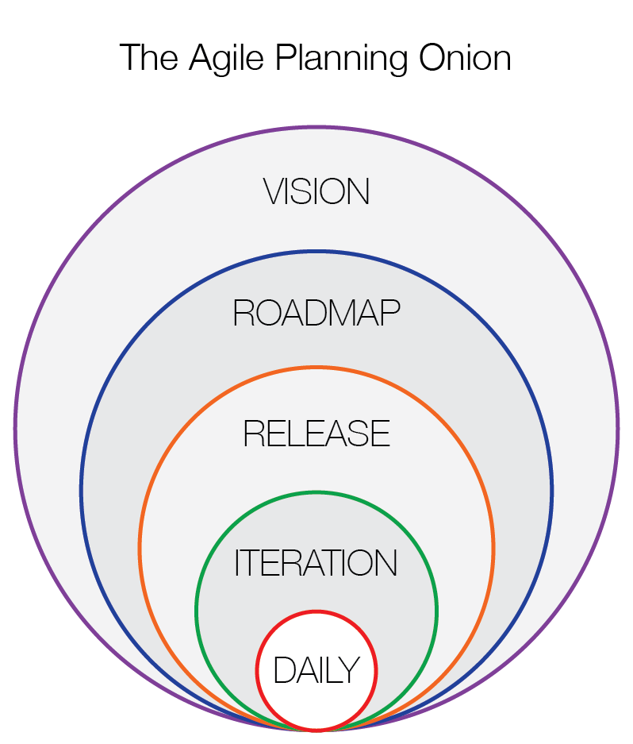
Planning Onion and different levels of Planning
It's a common myth that Agile and Scrum requires little or no planning
Planning is a regular event in an Agile environment and occurs regularly, even daily

Slide 5
Bring Agile to Your Team
1
2
3
Be Adaptive
In our industry, change is inevitable. Plans and people must be flexible in order to remain competitive in the market. Welcome feedback and change throughout projects, and view failure as an opportunity to grow. Agile teams aim to continuously improve, not remain the same.
Focus on the Customer
Any Agile project only exists because a customer has asked for something. The customer is a person with a problem that you can help solve. Plan around their needs, listen to their feedback, and evolve your strategies as their requirements change.
Deliver High Value and High Quality
Agile is not just about making something happen fast. Speed is important, but what you deliver is more important. Focus on what brings the most value to the customer, and limit work in progress so those items are done right.
Notes:
There is no failure, only feedback.
“We thought in terms of accounts, not people… the big transformation was to recognize that we are in a people business, that our customers are humans with their own personal journeys, and that we’d do well to obsess over how we could help them have a better human experience.”

Slide 6
Bring Agile to Your Team
4
5
6
Simplify
Accomplish tasks by focusing only on what is most important. Maximize the time spent on delivering what the customer needs, not on unnecessary work. Strive for efficiency while still delivering quality.
Communicate Constantly
Transparency is one of the main pillars of Agile. Communicate among teams and with customers as often as possible, preferably face-to-face. Be sure that everyone involved in a project is informed and aware of what is happening in the project.
Put Ownership on the Team
Agile practices aim to eliminate blame on individuals. Team members share responsibility for the whole project, not just certain aspects. If something goes wrong, the whole team must resolve the problem. If a project is successful, the whole team receives praise.
Notes:
4. Pragmatism – “When faced with an impossible problem, identify the real constraints. Ask yourself: Does it have to be done this way? Does it have to be done at all? Once you start breaking a problem down, it can seem easier to resolve”
6. Large piece is decision making (“Agility in the organization requires decision-making to be done as close to the customer feedback as possible.” - Bring Agile to the Whole Organization, Jeff Gothelf)

Slide 7
Bring Agile to Your Team
7
8
9
Stand Up
Even if your team is not using a pure Scrum framework, daily standups are a great way to keep team members aligned on project progress and roadblocks. Standups foster improved communication and visibility among teams, and encourage teams members to share ideas and help each other succeed.
Visualize Work
When the work in a project is represented visually, it is easier for teams to recognize and concentrate on the highest priority tasks. Real-time displays of work allow teams to quickly respond to changes and easily identify bottlenecks in workflows in order to assist each other in resolving issues.
Reflect
Like standups, business retrospectives are a powerful Agile strategy. Teams should strive to improve continuously just like their products do. Hold team retrospectives regularly to determine what is and is not working well among the team and with customers to improve relationships and efficiency.
Notes:
7 – benefits of daily standups/how to tailor to business (article)
9 – benefits of retrospectives (article)

Slide 8


What is an Agile Release?
Agile release is planned delivery of product features over a series of sprints. The length of release depends on the product, domain, market conditions etc.
- - - Release 1- - -
- - - - Release 2- - - -
- - - - Release 3- - - -
Incremental Delivery
Minimum Viable Product
First release is usually a MVP
Must have features
Some should have features
Focus on building the scalable
platform for future releases
Incremental Release N
Remaining must have and should
have features
Customer feedback on MVP release
Some nice to have features
Incremental Release N + 1
Remaining should have and nice to
have features
Customer feedback
Enhancements
Full product scope

Slide 9
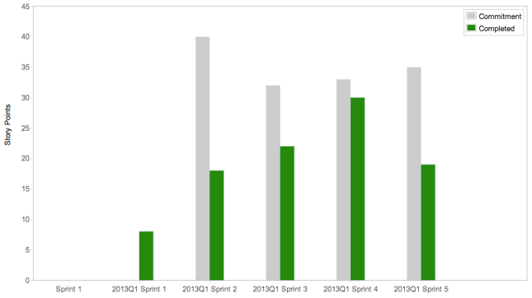
Velocity Charts
Velocity. By far the single most important word to any Agile team. Whether you are currently practicing Agile, looking to adopt within your organization or trying to achieve your Agile Nirvana, understanding Velocity is fundamental to achieving success with Agile. Beyond a basic understanding, it’s important that you learn how to measure, influence and improve upon it. Velocity is a point-in-time metric (unit), used to accurately measure the value that your product development teams are delivering to your business.
Like burndown charts, velocity charts are invaluable as they provide insight into how a team is progressing with their current and any previous iterations.

Slide 10
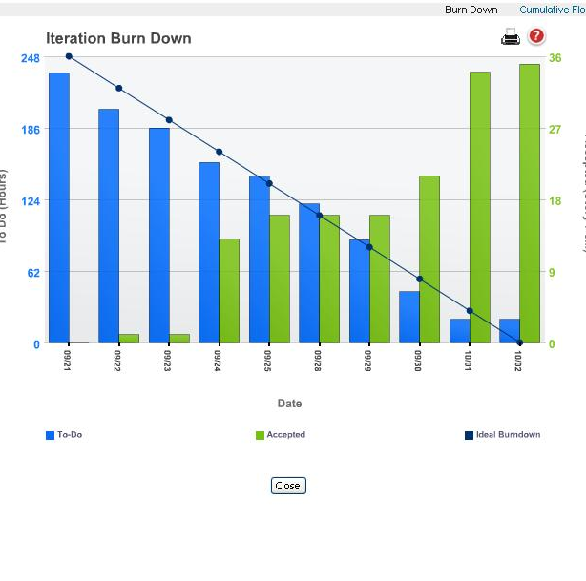
Agile Metrics
Burndown Charts
The blue bars represent work remaining, and the green bars represent the work completed.
The chart is created daily for the project leadership.
It provides “project intelligence” for leadership, and visibility into how the team is progressing on a daily basis.
If a team becomes blocked by an issue, it will show up in the chart as the blue bars will level off or increase.

